Slide 1
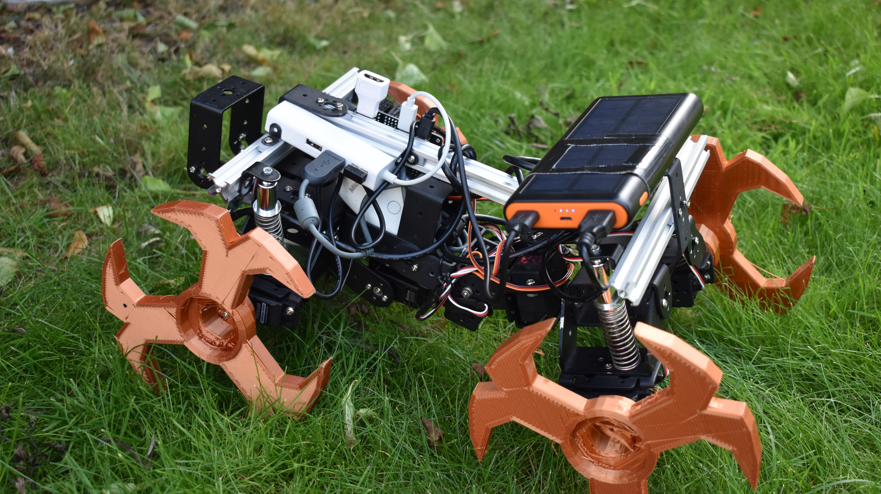
Evolving complex terrain navigation: Emergent contour following from a low-resolution sensor
Dexter R. Shepherd∗, James C. Knight∗ Department of Informatics, University of Sussex, Brighton, United Kingdom

Slide 2
Aims of the project
Use inspiration from nature to make a more resilient chassis (hardware)
Explore methods of enabling an agent to understand its own limitations (software)
Attempt to cross the reality gap from simulated terrain avoidance to physical robotics

Slide 3
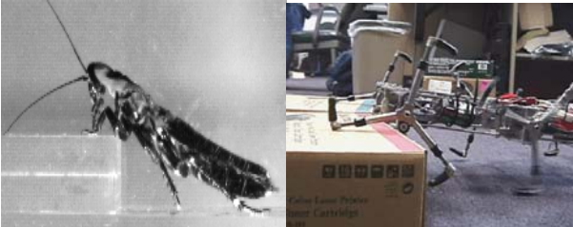
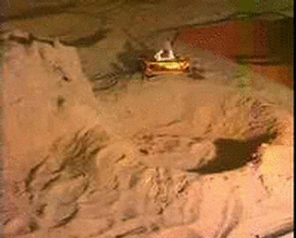
Inspiration
Cockroach locomotion
Cyclic leg movement
Back bending

Slide 4
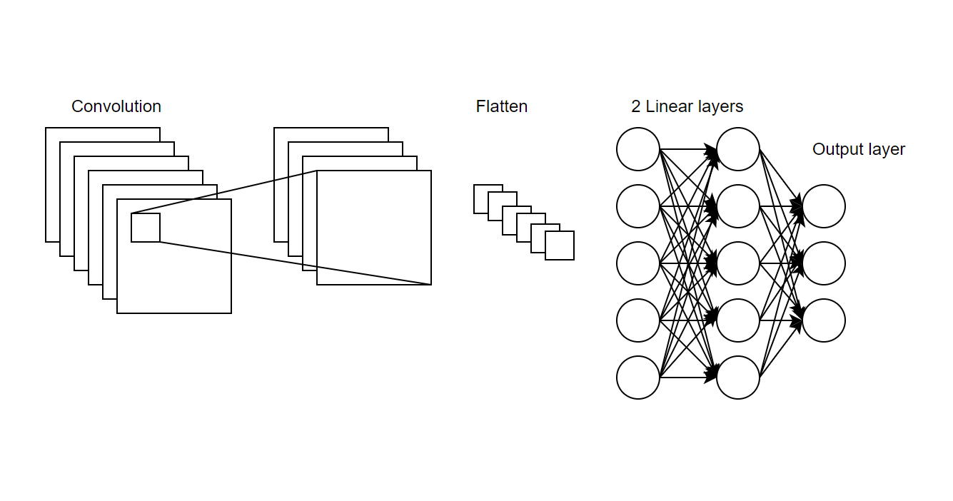
Genetic approach and network
Used due to large search space and no training data
Trialled different algorithms with conv 2D architecture
Microbial
Group evolution

Slide 5
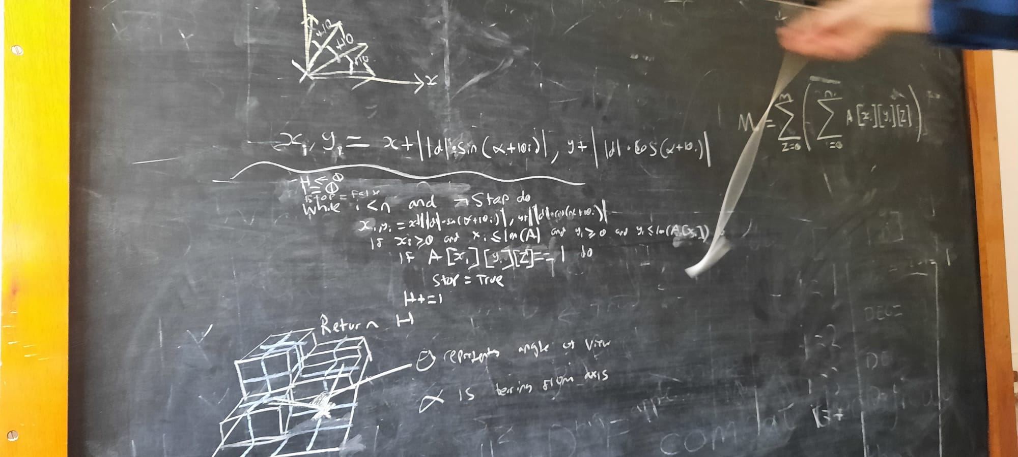
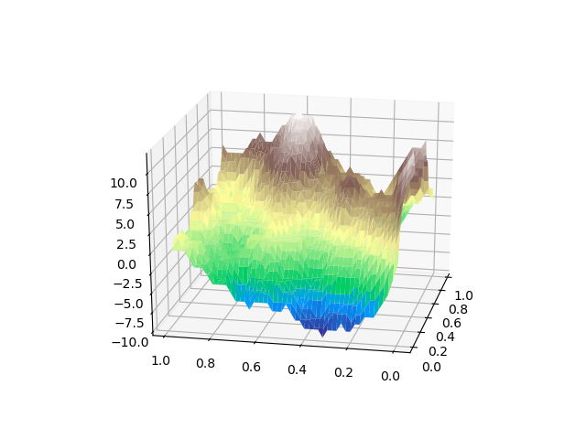
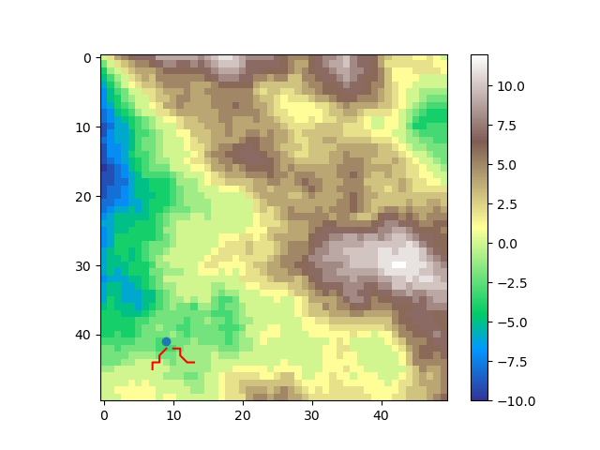
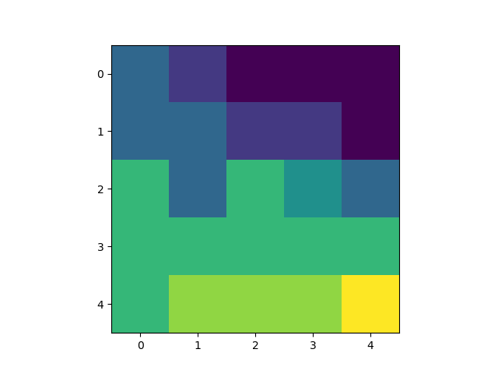


Simulation
Procedurally generated terrain
First person view
Fitness determined by energy and collision

Slide 6
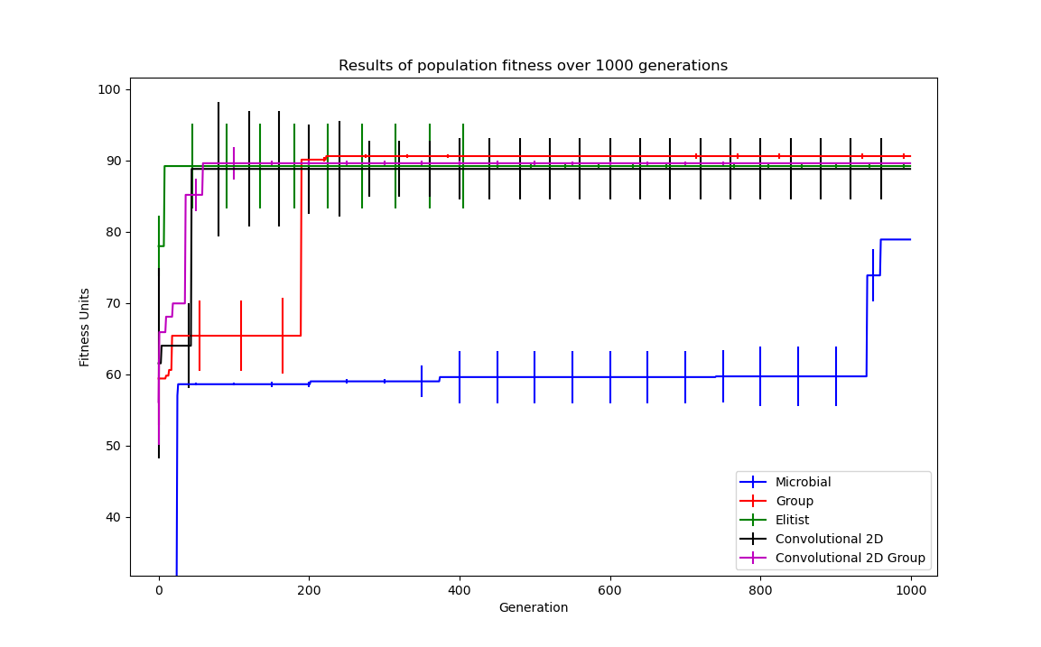
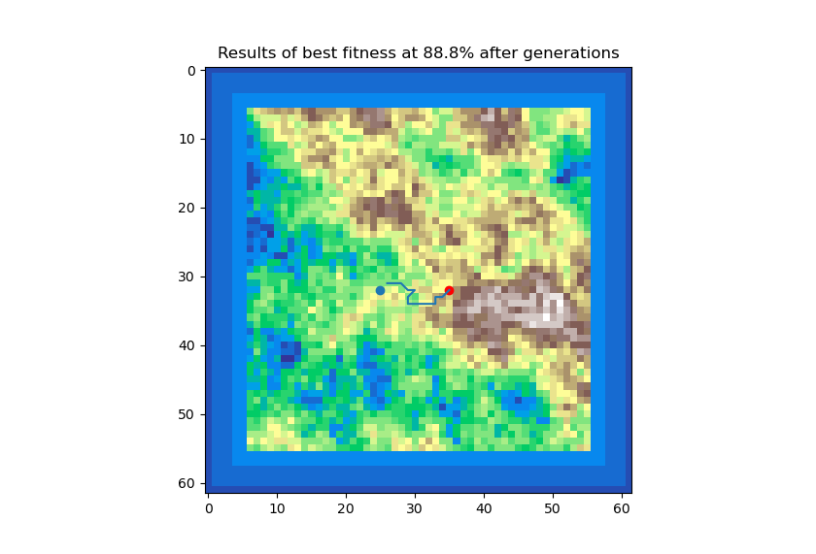
Simulation results
Performed best with a 2D convolutional neural network
Rule based approach outperformed evolution
Evolved to use contours
CNN Microbial

Slide 7
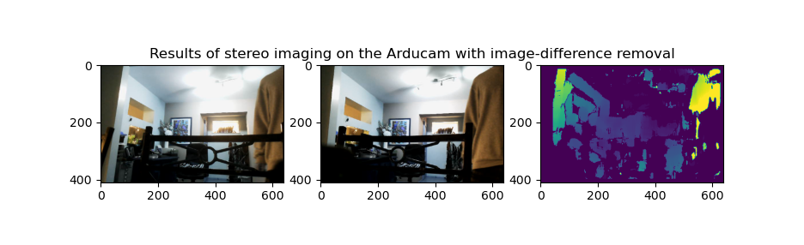
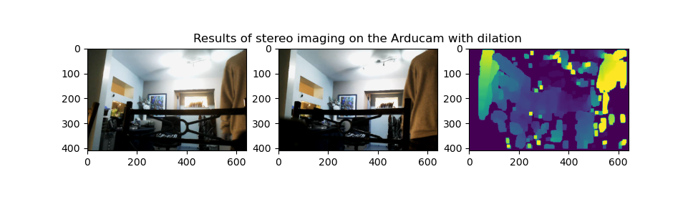
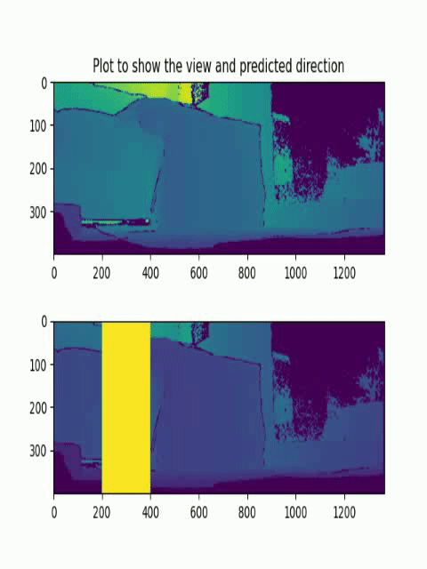
Computer vision
Stereo vision
Pre and post processing
Off-the-shelf Kinect

Slide 8
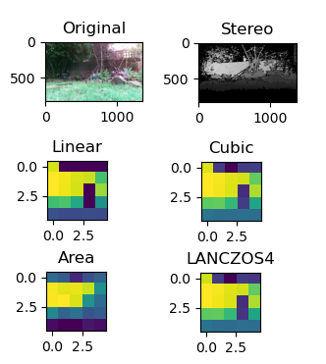
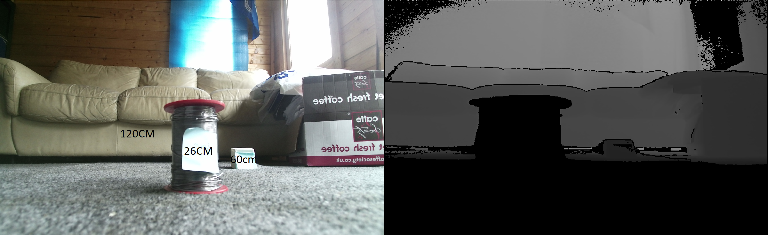
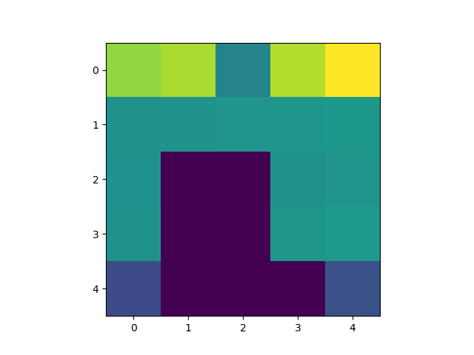
Crossing the reality gap
Applying trained model on the vision
Visual compression
Interpolation methods

Slide 9
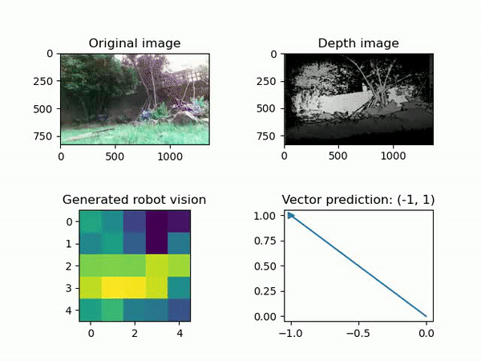
Results of crossing the reality gap
Conv2D network
Mainly avoided difficult terrain
Noise complications

Slide 10
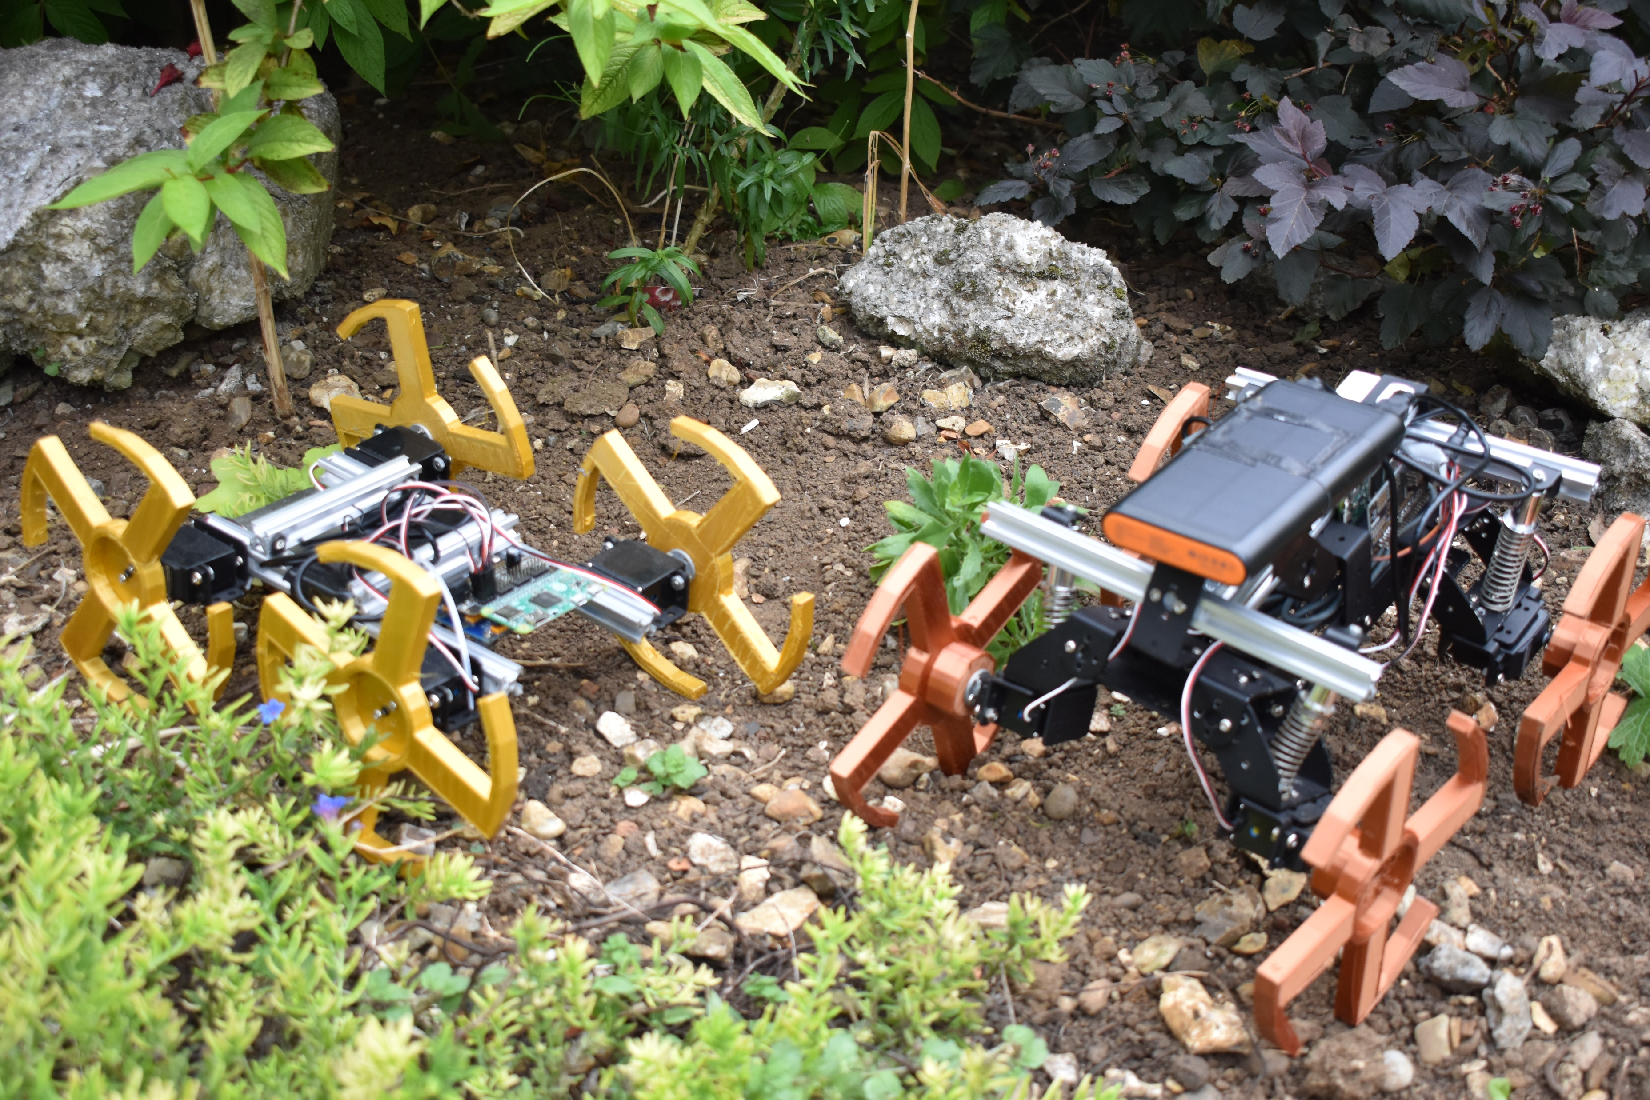
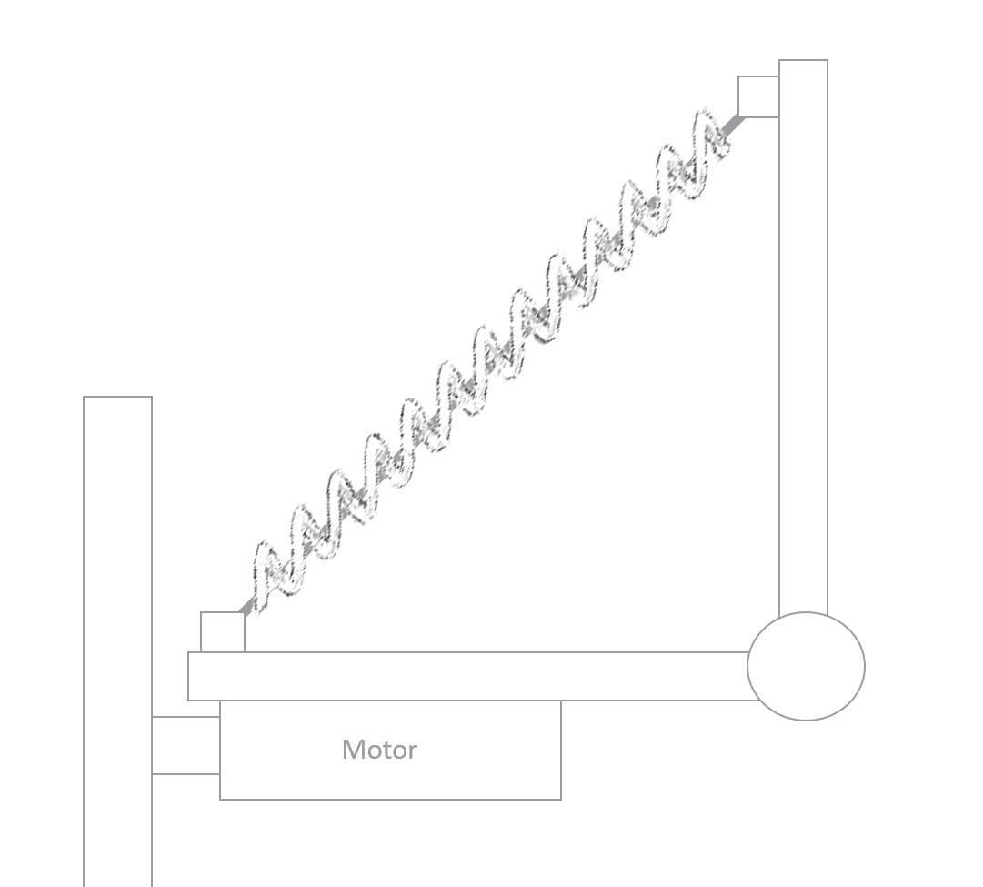
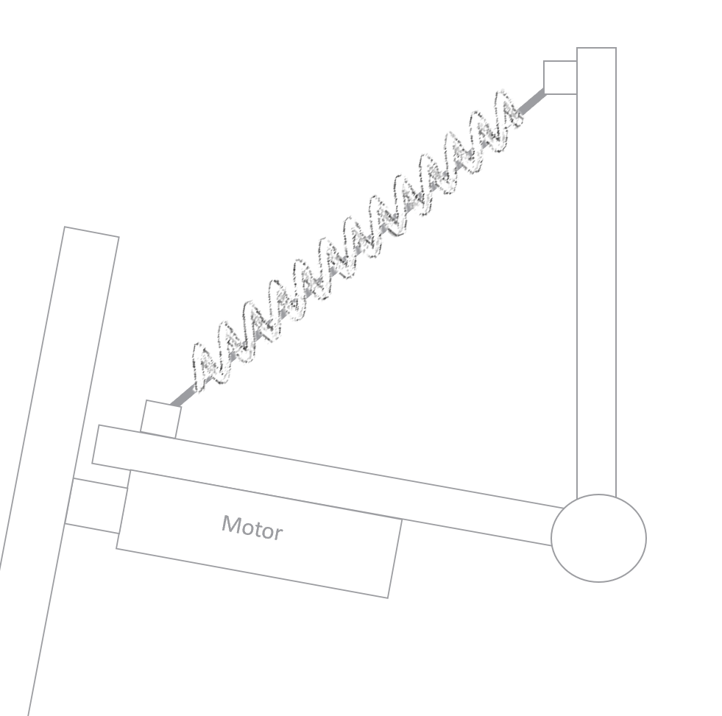
Physical robot implementation
Version 1 – no back bending
Version 2 – Back bending and suspension
Version 3 – Better rotating and improved Whegs
All using the Raspberry Pi Zero

Slide 11
Conclusions
Simulation showed proof of concept for evolved navigation
Low resolution sensing lead to correct predictions

Slide 12
References
Nicholas Tomko, Inman Harvey, Nathaniel Virgo, and Andrew Philippides. Many hands make light work: Further studies in group evolution. Artificial Life, 20(1):163–181, 2014
European Space Agency. Prolero. https://www.esa.int/Enabling_Support/Space_Engineering_Technology/Automation_and_Robotics/PROLERO
R.T. Schroer, M.J. Boggess, R.J. Bachmann, R.D. Quinn, and R.E. Ritzmann. Comparing cock- roach and whegs robot body motions. In IEEE International Conference on Robotics and Au- tomation, 2004. Proceedings. ICRA ’04. 2004, volume 4, pages 3288–3293 Vol.4, 2004.

